Slide 1
Mid-Term Talk Simulation of EEG-Activity Based on Sequential Sampling Models
M.Sc. Business Informatics Timo Zaoral

Slide 2
Table of Content
Motivation Recap
Approach
Preliminary results
Schedule for the next steps

Slide 3
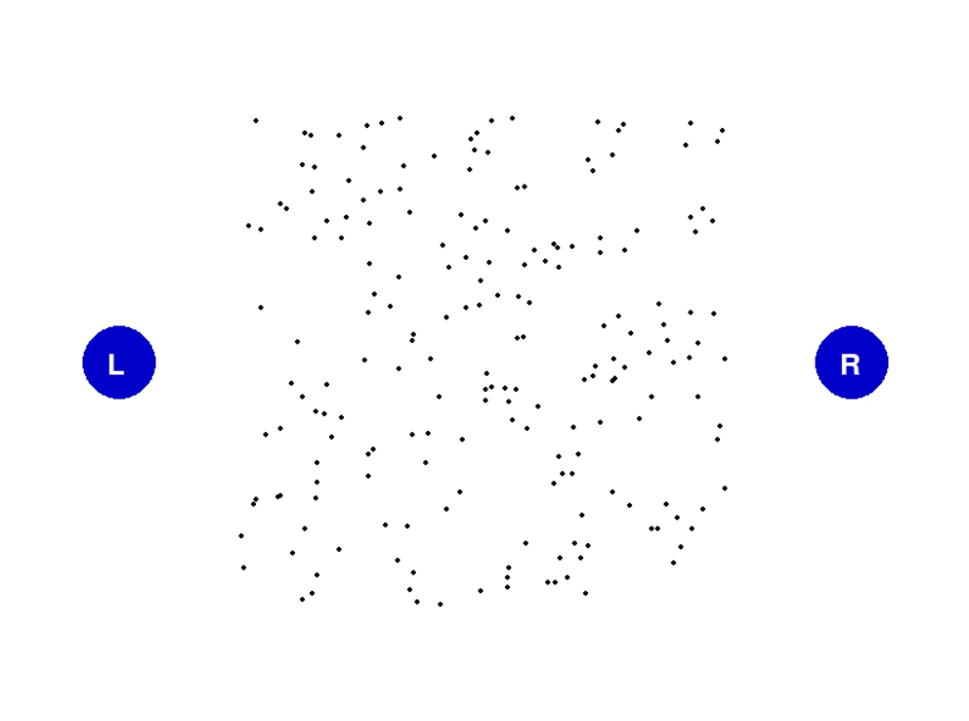
Motivation Recap
Changing coherence moving dots Experiment
own illustration
Notes:
In the task, dots move on a screen and a decision has to be made as to whether they move to the right or left. For this, a phase with incoherent/arbitrary movements was presented first, followed by coherent/steady movements. The number of coherent dots in the experiment was varied so that the researchers could investigate the neuronal processes of decision-making using the CPP at different levels of difficulty. Overall, this shows an experiment in which the evidence accumulation process in the brain is mirrored by the CPP. In der Aufgabe Bewegen sich Punkte auf einem Bildschirm und es ist zu entscheiden, ob sie sich nach Rechts oder Links bewegen. Dafür wurde zuerst eine Phase mit inkohärenten/willkürlichen Bewegungen präsentiert, gefolgt von kohärenten/gleichbleibenden Bewegungen. Die Anzahl an kohärenten Punkten im Experiment wurde variiert, sodass die Forschern, die neuronalen Prozesse der Entscheidungsfindung anhand vom CPP bei verschiedenen Schwierigkeitsgraden untersuchen konnten.

Slide 4
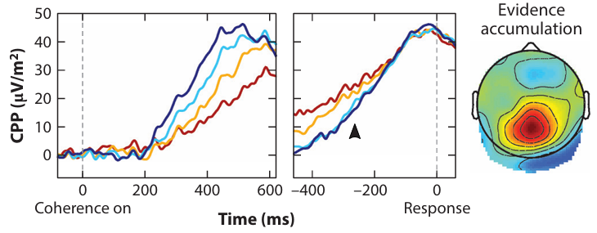
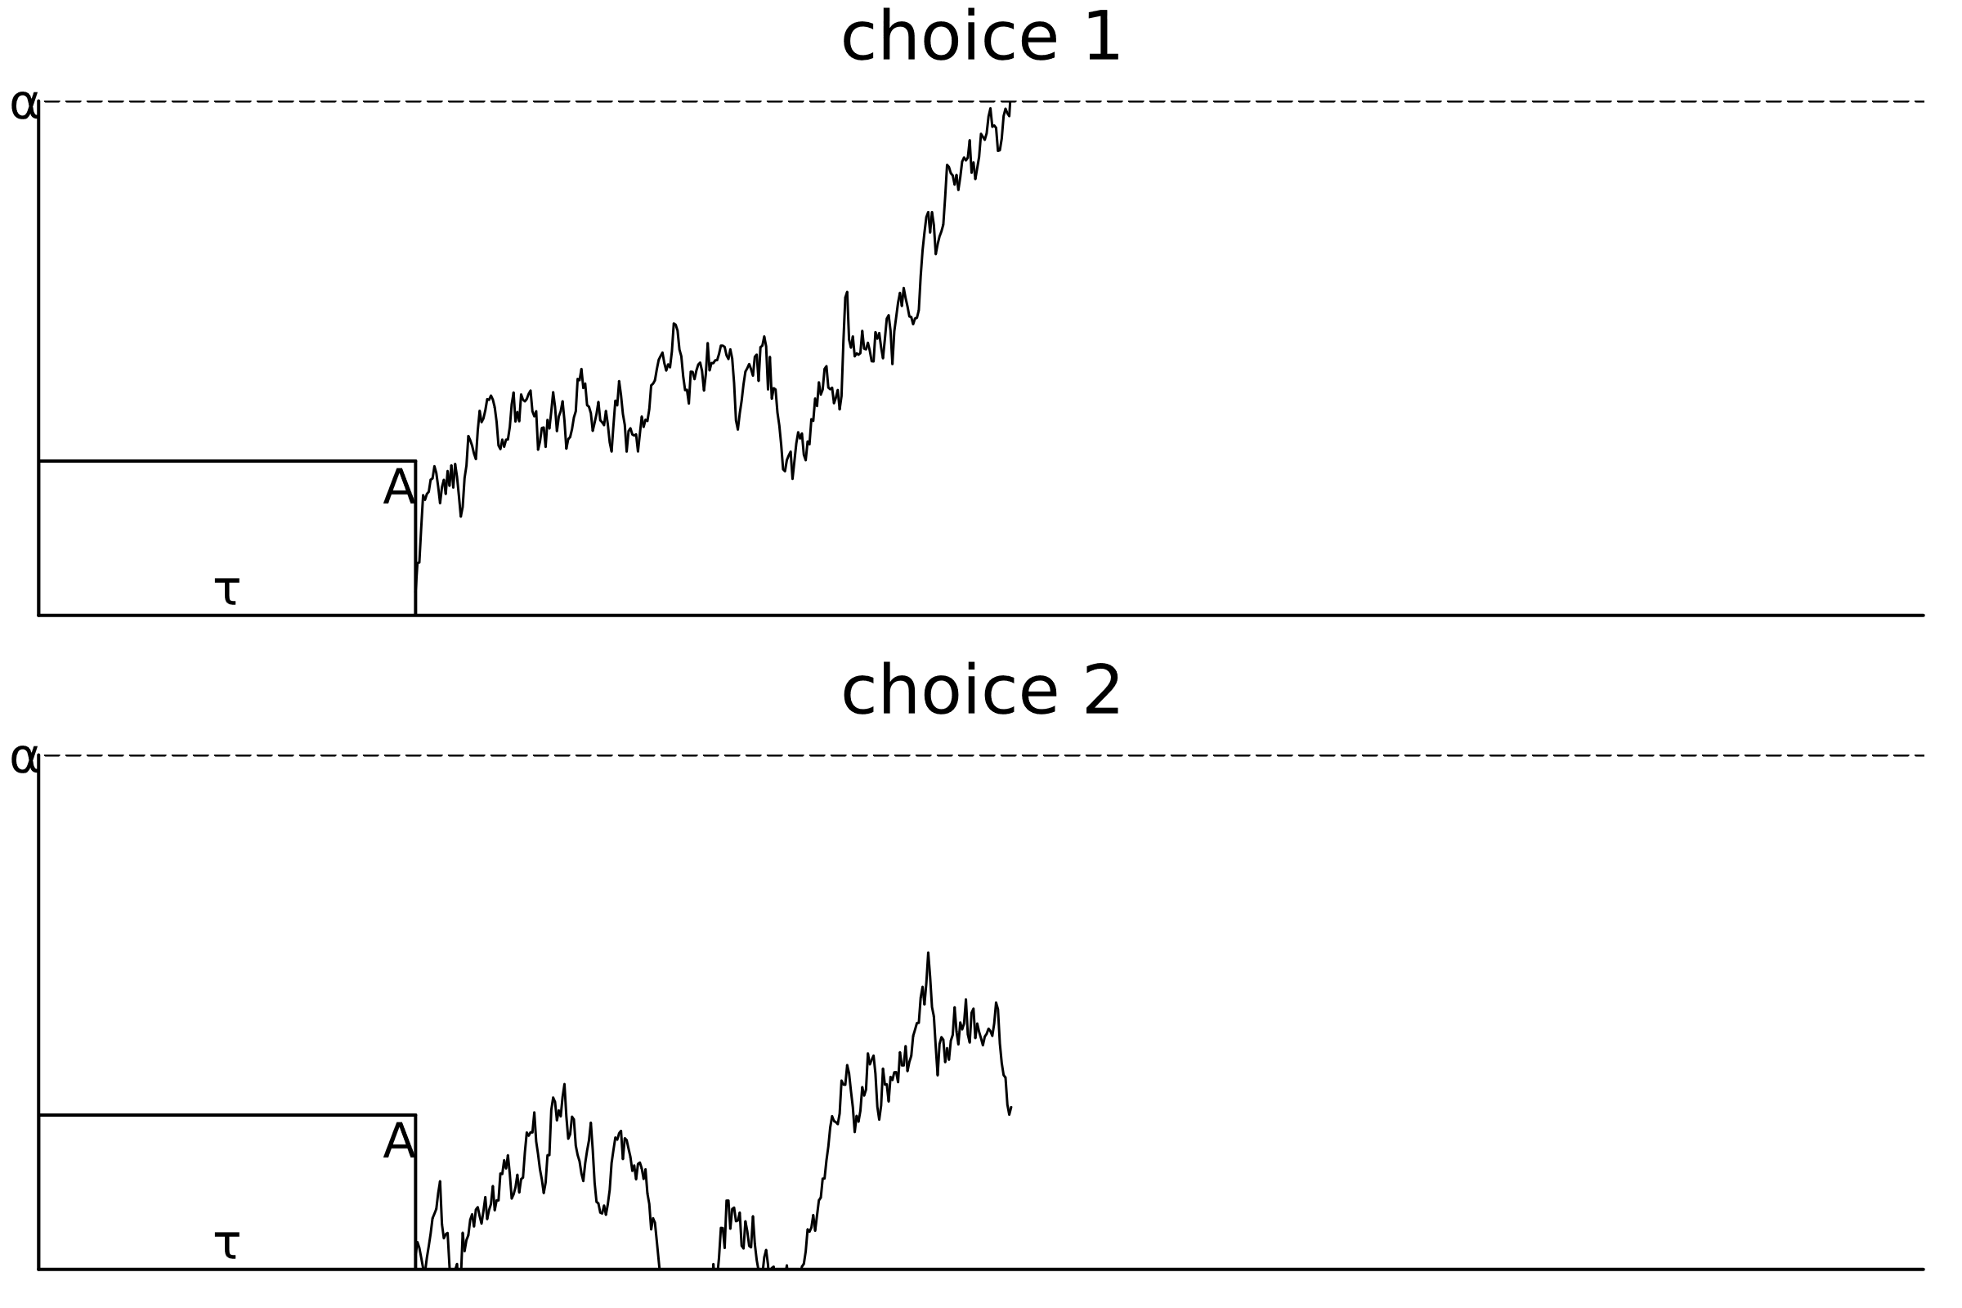
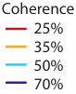
Motivation Recap
Evidence-dependent structural dynamics of the component centroparietal positivity (CPP) in the brain
Sequential sampling models (SSM) depict the decision-making process in the brain
Evidence
Kelly et al. Neurophysiology of Human Perceptual Decision-Making 2021 [1]
Evidence
Time
own illustration
Notes:
The number of coherent dots in the experiment was varied so that the researchers could investigate the neuronal processes of decision-making using the CPP at different levels of difficulty. Overall, this shows an experiment in which the evidence accumulation process in the brain is mirrored by the CPP.
On the right, we see an example of a Sequential Sampling Model, which is known in the literature to model this decision-making process in the brain. SSMs accumulate evidence at a certain rate over time, depending on the type of model, until one or more thresholds are reached and the decision is made.

Slide 5
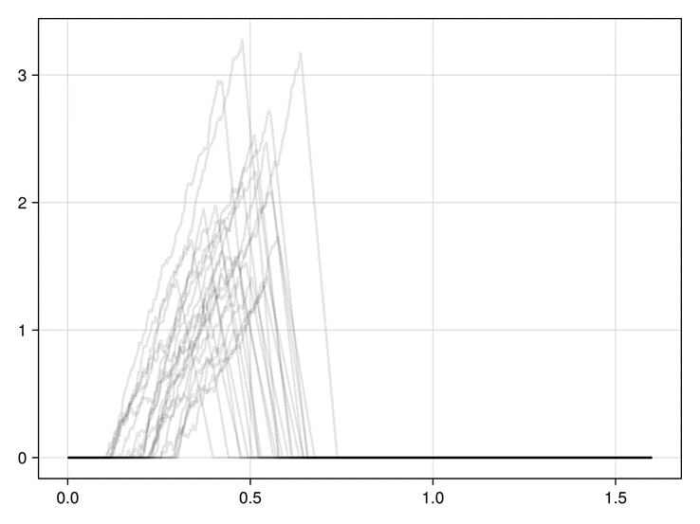
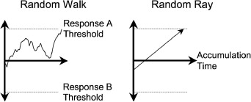
Approach
Theoretical Description of Sequential Sampling Models
Selection of the Models:
drift-diffusion model (DDM)
linear ballistic accumulator (LBA)
Kelly et. al Model of neural activity
Brown et al. The simplest complete model of choice response time: Linear ballistic accumulation 2008 [2]
Own illustration based on Kelly et al. Code converted to Julia
Notes:
Firstly, I looked at the sequential sampling models and selected two models in addition to the Kelly model that I will use for the later implementation. Then I looked at the models theoretically and wrote a description for all these models, which will also be used in the later thesis.
On the left we have the comparison between the DDM and the LBA, the ddm has a constant drift rate combined with a diffusion factor that makes the movement random and adds a bit of noise. LBA is linearly accumulated and has only a constant drift rate in one direction. Therefore, the difference is also that LBA cannot reach two different thresholds as ddm can in a single trial.
On the right, we see some traces of the Kelly et al. model, which is inspired by a DDM but has more specific parameters that make it more adaptable. For example, stimulus processing and motor processes can vary.

Slide 6
Approach
2. Reimplementation of the Kelly et. al Model of neural activity
3. Integration into UnfoldSim (Ongoing…)
Understanding the code
structured and methodical Reimplementation
Code and parameters Documentation
Introduction to UnfoldSim usage
Adapting implementation to package paradigms
Splitting functionalities and documenting code.

Slide 7
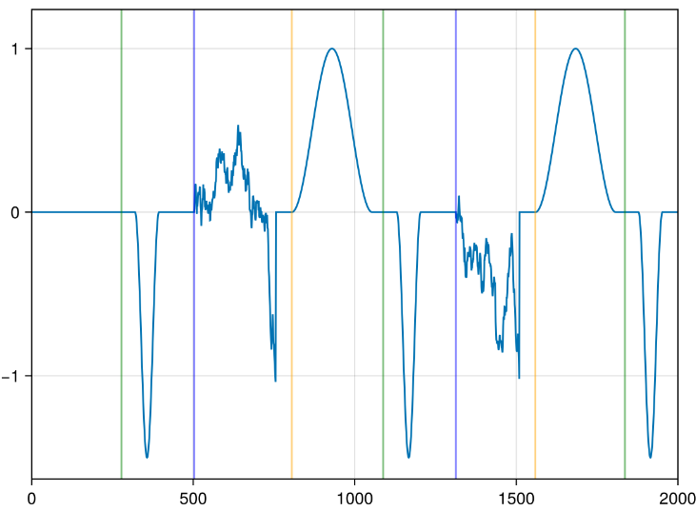
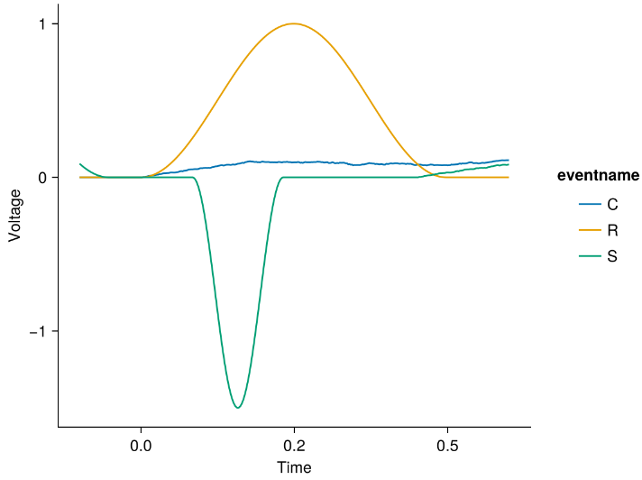
Preliminary results - DDM
Legend Stimulus(S) Component(C) Response(R)
CPP
Time
own illustration
own illustration

Slide 8
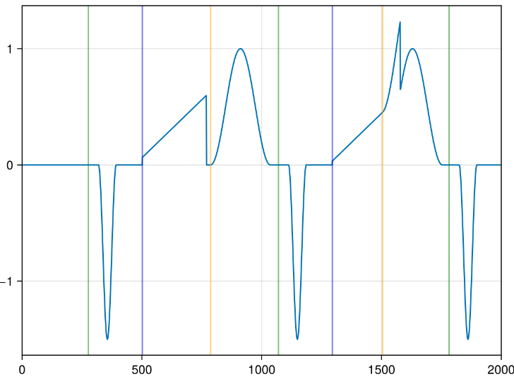
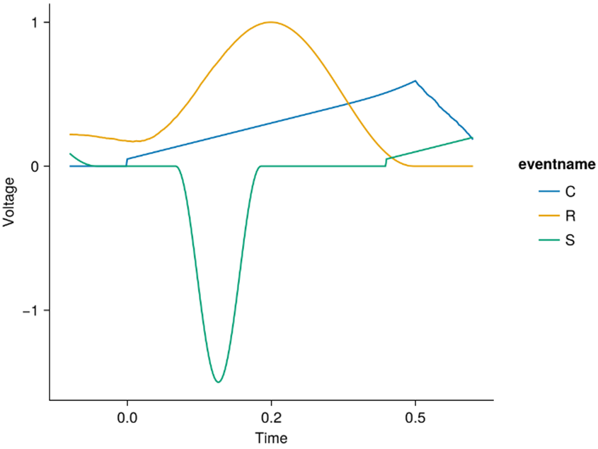

Preliminary results - LBA
Legend Stimulus(S) Component(C) Response(R)
CPP
Time
own illustration
own illustration

Slide 9
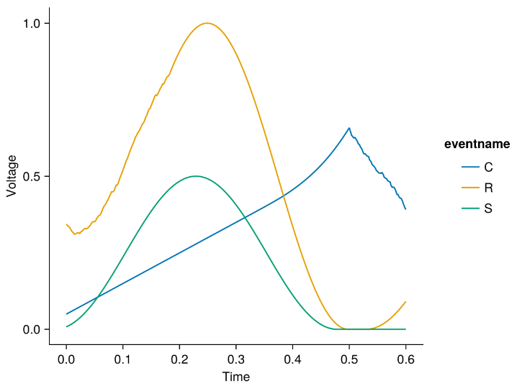
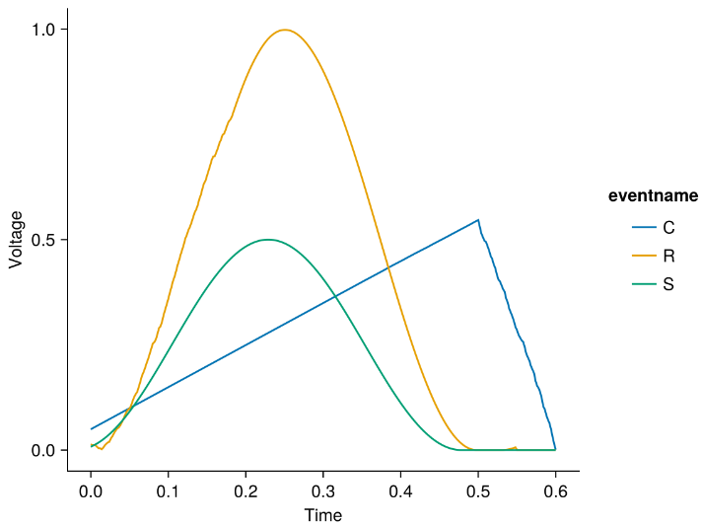
Preliminary results - Overlap
ERP
DECONV
own illustration
own illustration

Slide 10

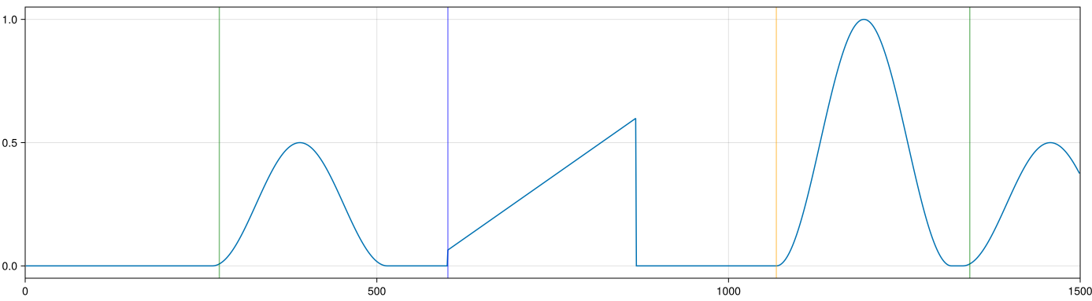
Preliminary results - UnfoldSim
SequenceDesign (S, C, R)
Legend Stimulus(S) Component(C) Response(R)
Onsets (UniformOnset)
DriftComponent (DDM, LBA, KellyModel)
Onsets (DriftOnset)
own illustration

Slide 11
Schedule for the next steps
Timeline between 22.01. until 31.03.
Finish the Implementation and Documentation
Overall test of the implemented functionalities, especially edge cases
Integrate into UnfoldSim on a feature Branch
Write the thesis
On Top: Comparison of Models

Slide 12
Questions?

Slide 13
Literature
[1]: Redmond G. Connell and Simon P. Kelly. Neurophysiology of human perceptual decision making. Annual Review of Neuroscience, 44(Volume 44, 2021):495–516, 2021.
[2]: S. D. Brown and A. Heathcote, “The simplest complete model of choice response time: Linear ballistic accumulation,” Cognitive Psychology, vol. 57, no. 3, pp. 153–178, 2008, doi: https://doi.org/ 10.1016/j.cogpsych.2007.12.002.

Slide 14


Motivation Recap
L
R

Slide 15
Preliminary results - UnfoldSim
Model simulation
Component
Onset
DDM
Drift Component
Drift Onset
LBA
Kelly et. al Model

Slide 16
Design
Component
Model simulation
Onset
SingleSubjectDesign
DriftComponent
KellyModel
SequenceOnset
SequenceDesign
DriftComponent functions
SSM_Simulation functions
DriftOnset
RepeatDesign
SequenceOnset/ DriftOnset functions

Slide 17
Event | Onset
S | UniformOnset(100)
C | DriftOnset()
R | UniformOnset(150)
Event | Onset per component | Onset shifted | Onset accumulated
S | 100 | 150 | 150
C | 320 | 100 | 250
R | 150 | 320 | 570
S | 100 | 150 | 720
C | 280 | 100 | 820
R | 150 | 280 | 1100

Slide 18
Design
Onset
Component
Model simulation
Drift Onset
Drift Onset
Drift Component
DDM
LBA
Kelly et. al Model

Slide 19
Preliminary results - UnfoldSim
Sequence Design
Components (S, C, R)
Drift Component (DDM, LBA, Kelly)
Onsets (Drift-Onset or Uniform-Onset)

Slide 20
generate_Events(design)
Foreach(event)
return rts, traces
event
get_model_parameters (event, parameters)
SSM_Simulate(rng, model, sfreq, max_length

Slide 21

SequenceDesign (S, C, R)
Stimulus(S)
Response(R)
Component(C)
Onsets (UniformOnset)
DriftComponent (DDM, LBA, KellyModel)
Onsets (DriftOnset)
own illustration

Slide 22
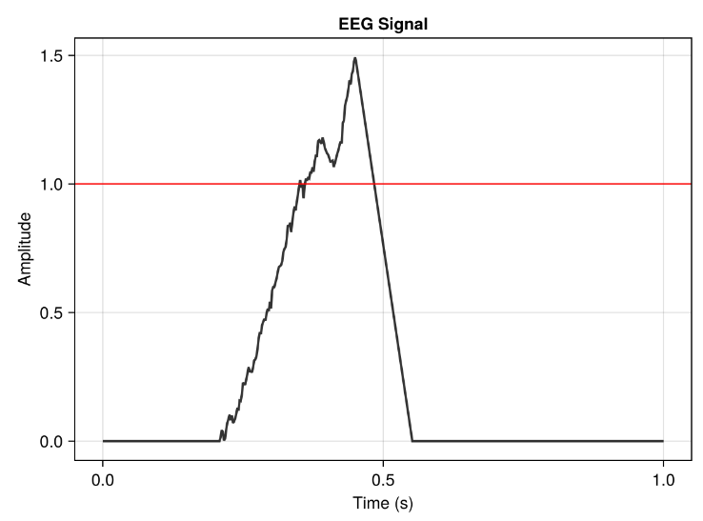
Post accumulation spike
Boundary
Ramp down process
Drift rate + Accumulation noise
Sensory encoding delay
Motor encoding delay

Slide 23
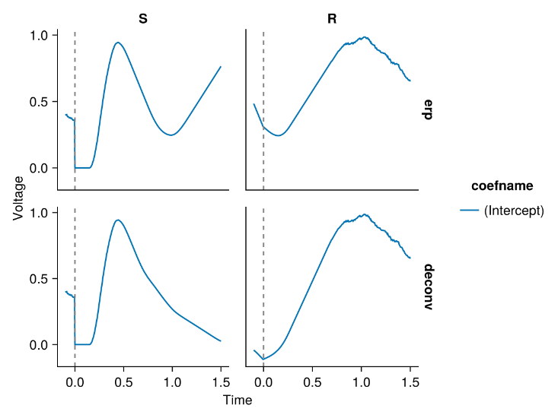
Potential activity
No activity

